Slide 1
Rashmita Kikani Netflix Data analysis

Slide 2
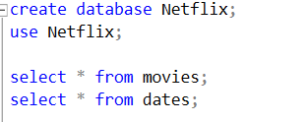
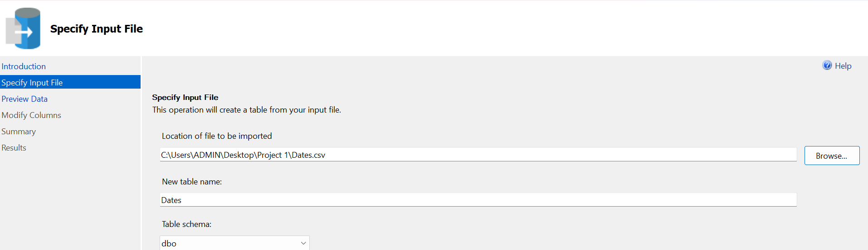
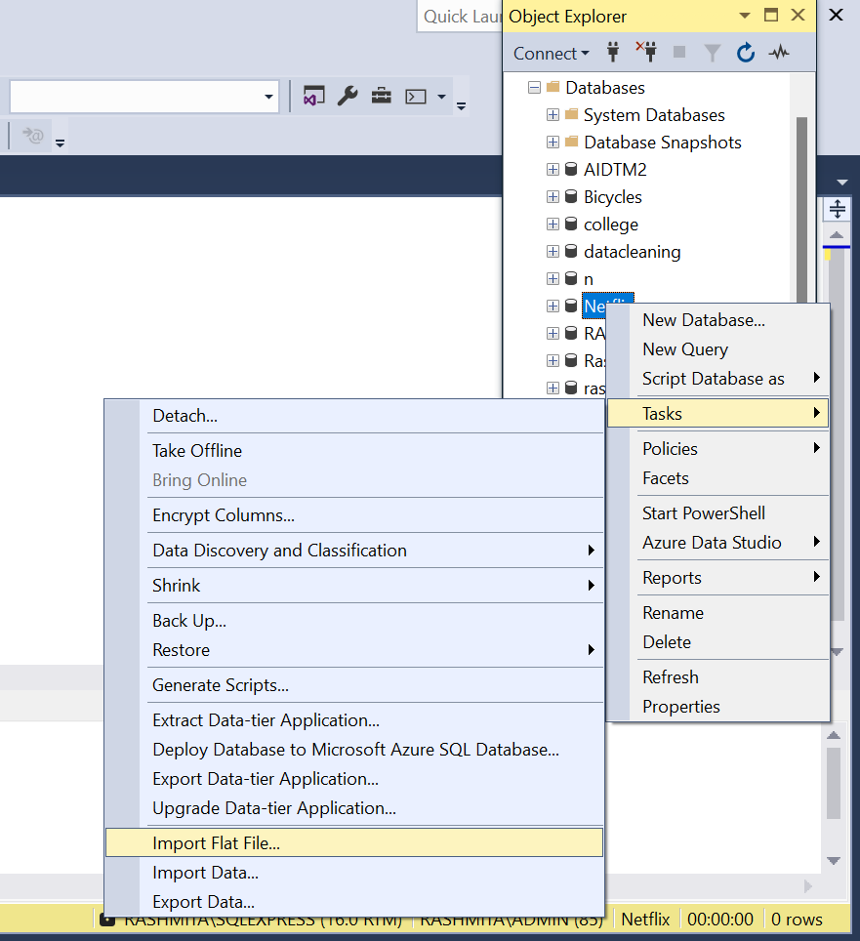
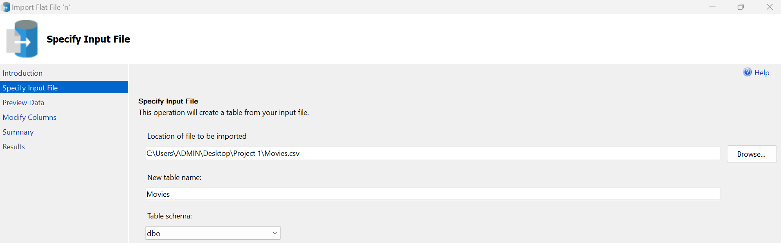
Import data to the database

Slide 3
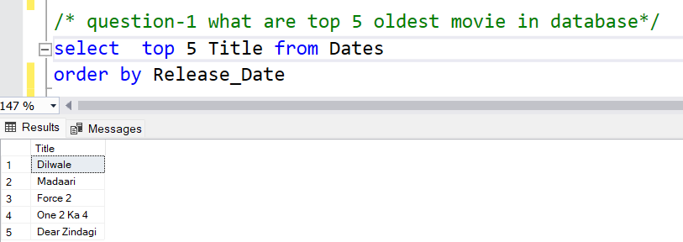
Interpretation-
This query aims to identify the five oldest movies in the database by ordering the Dates table in ascending order of the Release Date and selecting the top five results. By focusing on the oldest entries, this query highlights the earliest films in the database.

Slide 4
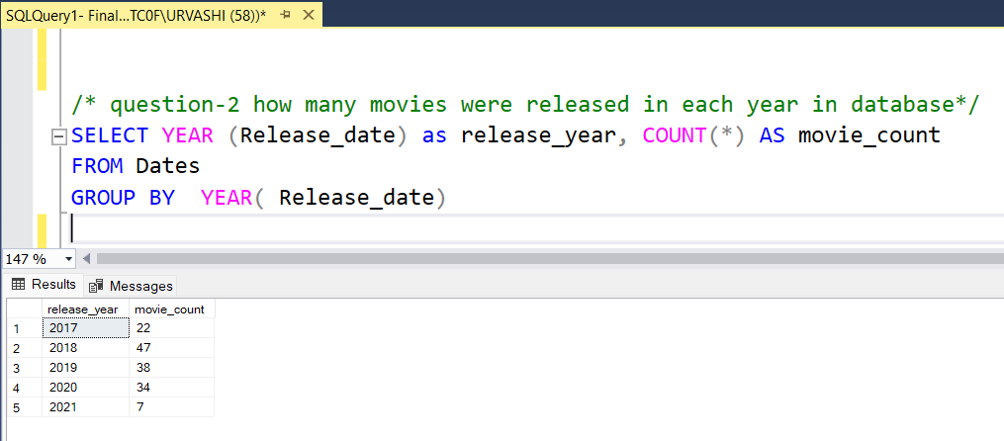
Interpretation-
From the output, we can see a 113.6% increase in releases from 2017 (22 movies) to 2018 (47 movies), indicating a significant growth in the number of movies released that year. However, releases declined by 19.1% in 2019 (38 movies) and 10.5% in 2020 (34 movies), showing a gradual decrease after the 2018 peak. In 2021, releases dropped sharply to just 7 movies, marking an 79.4% decrease from the previous year, likely due to external factors like the COVID-19 pandemic impacting production and release schedules.

Slide 5
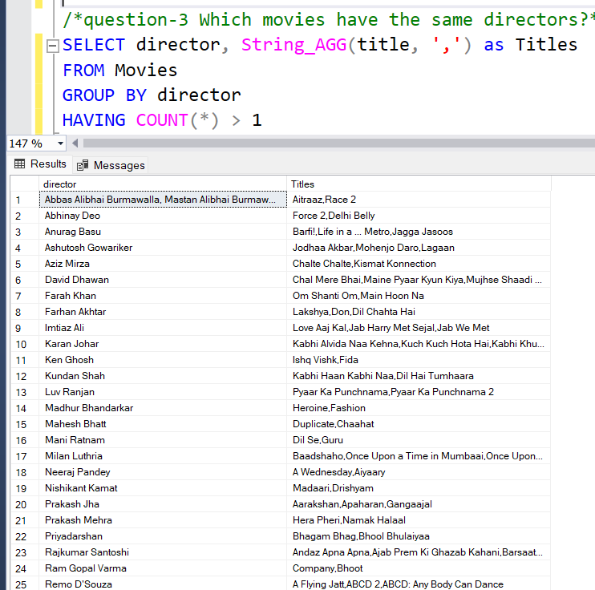
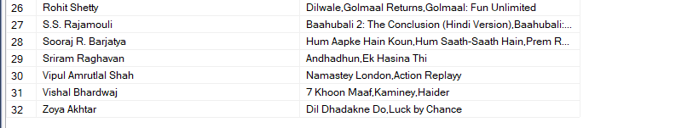
Interpretation-
The output shows multiple movies directed by the same directors.
This query reveals directors who are prolific within this database, directing multiple movies that may share similar themes, styles, or genres. For example:
Genre Consistency: Directors like Sooraj R. Barjatya, known for family dramas, have directed multiple films that align with this genre, which can appeal to fans looking for similar movie types.
Collaborative Works: Some directors, such as Abbas Alibhai Burmawalla and Mastan Alibhai Burmawalla, often co-direct films, suggest a collaborative style or partnership that produces a consistent body of work.

Slide 6
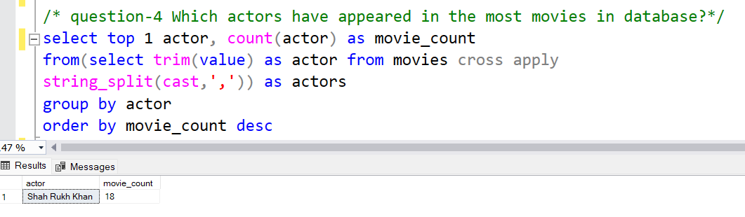
Interpretation-
Shah Rukh Khan, appearing in 18 movies, is the actor with the most appearances in this database, highlighting his popularity and impact.

Slide 7
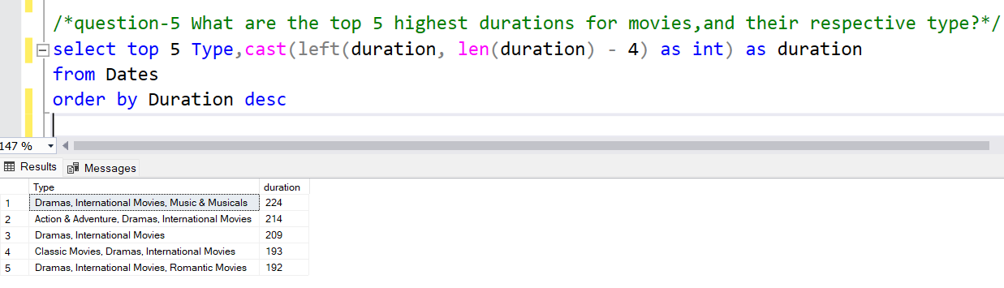
Interpretation-
The top 5 longest movies in this database are primarily dramas and international films, with durations ranging from 192 to 224 minutes. This pattern reflects a trend where complex storytelling and genre-specific elements contribute to extended runtimes, offering immersive viewing experiences.

Slide 8
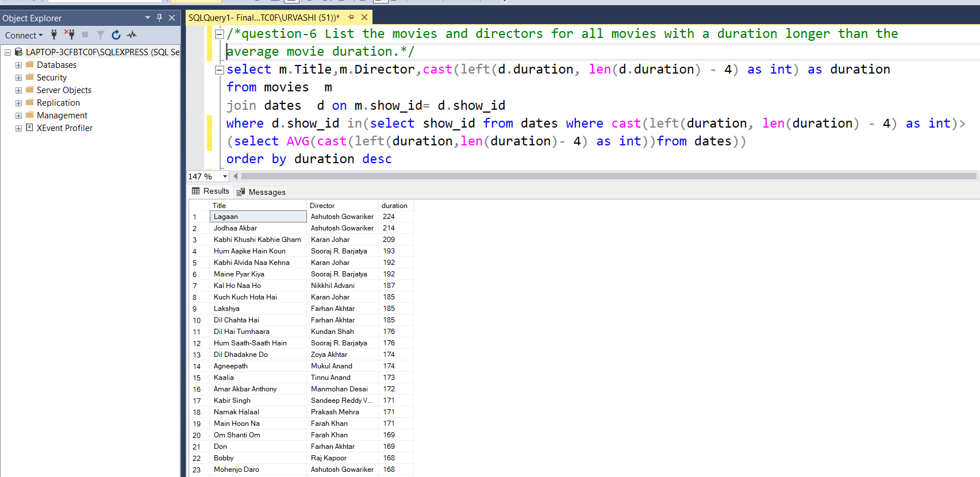
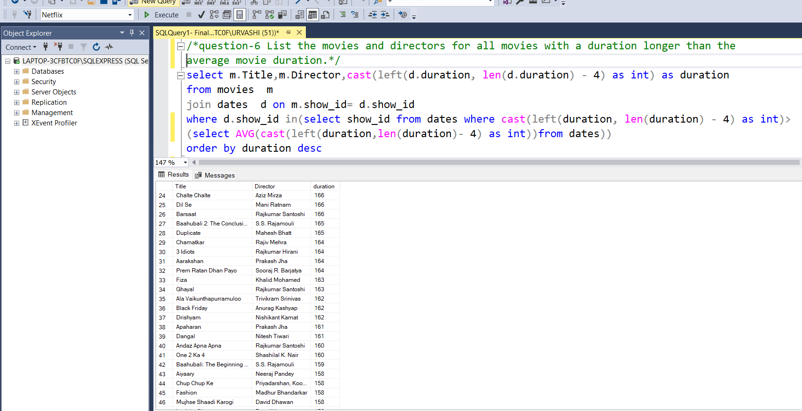
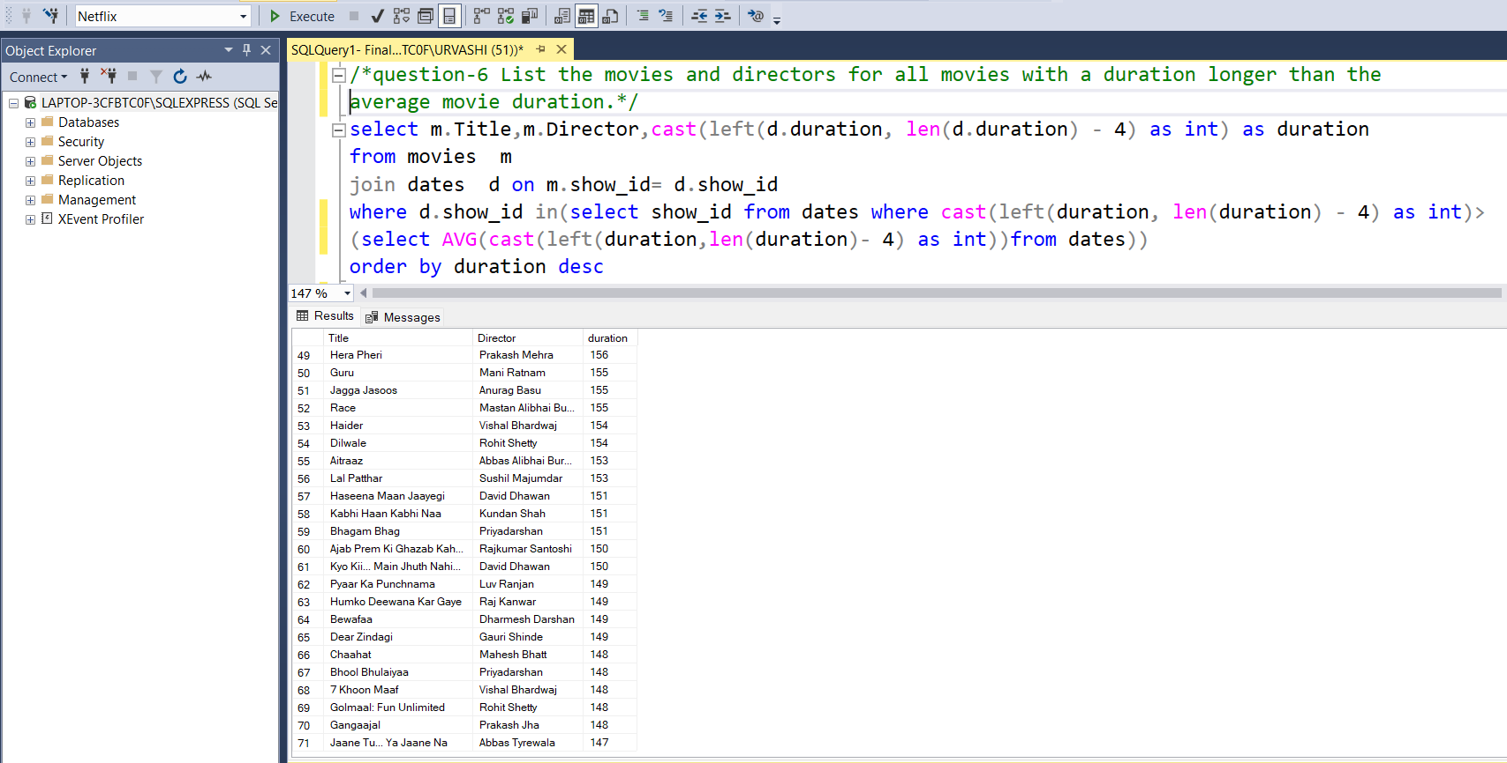
Interpretation-
In this dataset, the average movie duration is 146 minutes. Out of a total of 148 movies, 71 movies (about 48%) have durations exceeding the average. This nearly even split in durations suggests a balanced mix of both shorter and longer films in the collection.

Slide 9
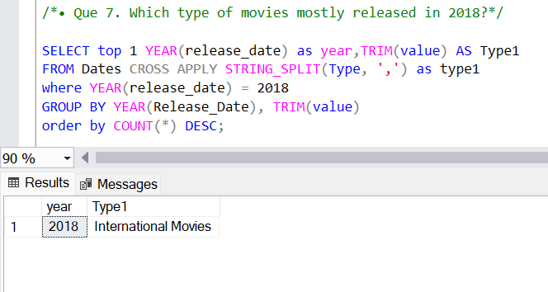
Interpretation-
In 2018, International Movies were the most released movie types in the dataset. This suggests a strong preference for films that blend humor with emotional or dramatic storytelling.

Slide 10

THANK YOU

